Slide 1

Chapter 20 – Graphical User Interfaces

Slide 2

Chapter Goals
To use layout managers to arrange user‑interface components in a container
To use text components to capture and display text in a graphical application
To become familiar with common user-interface components, such as radio buttons, check boxes, and menus
To browse the Java documentation effectively

Slide 3
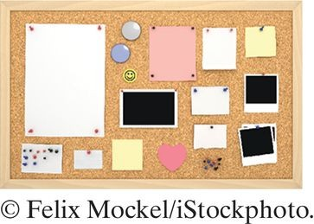
Layout Management
Build user interface by adding components into containers.
Use a layout manager to place the components.
JFrame uses Flow layout by default.

Slide 4
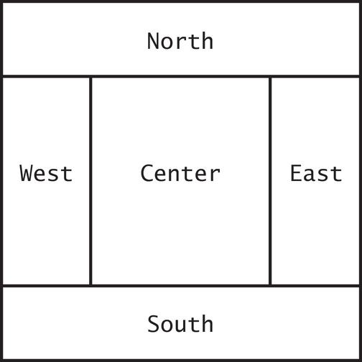
Border Layout
Components are placed toward areas of a container NORTH, EAST, SOUTH, WEST, or CENTER.
Specify one when adding components:
panel.setLayout(new BorderLayout());
panel.add(component, BorderLayout.NORTH);
Figure 1 Components Expand to Fill Space in the Border Layout

Slide 5
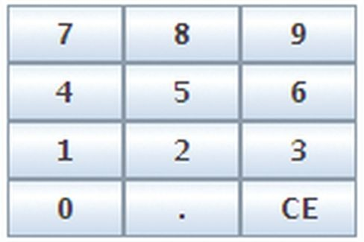
Grid Layout
Components are placed in boxes in a simple table arrangement. Specify the size (rows then columns) of the grid.
Then add components which will be placed from the upper left, across, then down.
JPanel buttonPanel = new JPanel(); buttonPanel.setLayout(new GridLayout(4, 3)); buttonPanel.add(button7); buttonPanel.add(button8); buttonPanel.add(button9); buttonPanel.add(button4);
. . .
Figure 2 The Grid Layout

Slide 6
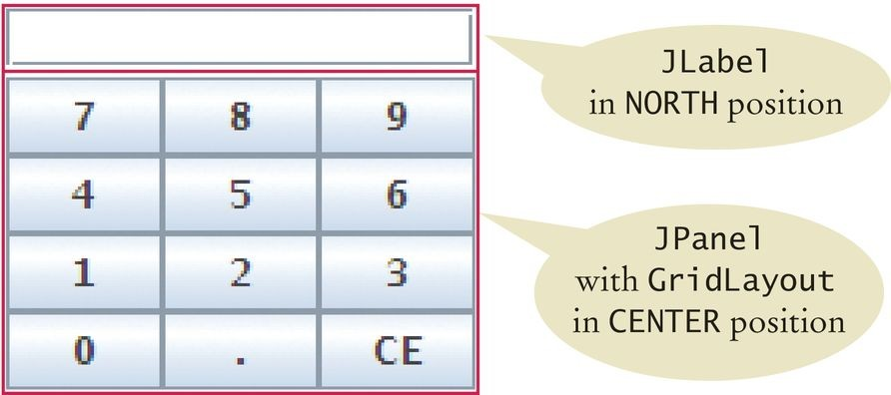
Achieving Complex Layouts
Create complex layouts by nesting panels.
Give each panel an appropriate layout manager.
Panels have invisible borders, so you can use as many panels as you need to organize components.
JPanel keypadPanel = new JPanel(); keypadPanel.setLayout(new BorderLayout()); buttonPanel = new JPanel(); buttonPanel.setLayout(new GridLayout(4, 3)); buttonPanel.add(button7); buttonPanel.add(button8);
// . . .
keypadPanel.add(buttonPanel, BorderLayout.CENTER); JLabel display = new JLabel("0"); keypadPanel.add(display, BorderLayout.NORTH);
Figure 3 Nesting Panels

Slide 7
Using Inheritance
Use inheritance for complex frames. Design a subclass of JFrame:
Store components as instance variables. Initialize them in the constructor of your subclass.
Easy to add helper methods to organize code.
public class FilledFrame extends JFrame
{
// Use instance variables for components private JButton button; private JLabel label;
private static final int FRAME_WIDTH = 300; private static final int FRAME_HEIGHT = 100; public FilledFrame()
{
// Now we can use a helper method createComponents();
// It is a good idea to set the size in the frame constructor setSize(FRAME_WIDTH, FRAME_HEIGHT);
}
private void createComponents() { button = new JButton("Click me!");
label = new JLabel("Hello, World!");
JPanel panel = new JPanel(); panel.add(button);
panel.add(label); add(panel);
}
}

Slide 8
Using Inheritance
FillledFrameViewer2 main method:
public class FilledFrameViewer2
{
public static void main(String[] args)
{
JFrame frame = new FilledFrame(); frame.setTitle("A frame with two components");
frame.setDefaultCloseOperation(JFrame.EXIT_ON_CLOSE); frame.setVisible(true);
}
}

Slide 9
Self Check 20.1
What happens if you place two buttons in the northern position of a border layout? Try it out with a small program.
Answer: Only the second one is displayed.

Slide 10
Self Check 20.2
How do you add two buttons to the northern position of a frame so that they are shown next to each other?
Answer: First add them to a panel, then add the panel to the north end of a frame.

Slide 11
Self Check 20.3
How can you stack three buttons one above the other?
Answer: Place them inside a panel with a GridLayout that has three rows and one column.

Slide 12
Self Check 20.4
What happens when you place one button in the northern position of a border layout and another in the center position? Try it out with a small program if you aren’t sure.
Answer: The button in the north stretches horizontally to fill the width of the frame. The height of the northern area is the normal height. The center button fills the remainder of the window.

Slide 13
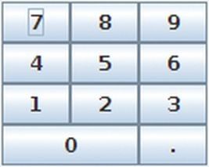
Self Check 20.5
Some calculators have a double-wide 0 button, as shown below. How can you achieve that?
Answer: To get the double-wide button, put it in the south of a panel with border layout whose center has a 3 × 2 grid layout with the keys 7, 8, 4, 5, 1, 2. Put that panel in the west of another border layout panel whose eastern area has a 4 × 1 grid layout with the remaining keys.

Slide 14
Self Check 20.6
Why does the FilledFrameViewer2 class declare the frame variable to have class
JFrame, not FilledFrame?
Answer: There was no need to invoke any methods that are specific to FilledFrame. It is always a good idea to use the most general type when declaring a variable.

Slide 15
Self Check 20.7
How many Java source files are required by the application in Section 20.1.3 when we use inheritance to declare the frame class?
Answer: Two: FilledFrameViewer2, FilledFrame.

Slide 16
Self Check 20.8
Why does the createComponents method of FilledFrame call add(panel), whereas the main method of FilledFrameViewer calls frame.add(panel)?
Answer: It’s an instance method of FilledFrame, so the frame is the implicit parameter.

Slide 17
Common Error 20.1
You add components like buttons or labels:
panel.add(button); panel.add(label); panel.add(carComponent);
Default size for component is 0 by 0 pixels so car component will not be visible.
Use setPreferredSize:
carComponent.setPreferredSize(new Dimension(CAR_COMPONENT_WIDTH, CAR_COMPONENT_HEIGHT));
Only needed for painted components.

Slide 18
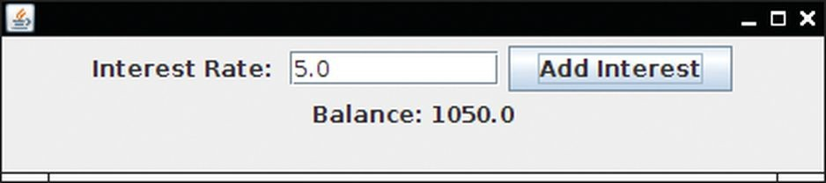
Processing Text Input
Dialog boxes allows for user input.
Popping up a separate dialog box for each input is not a natural user interface.
Most graphical programs collect text input through text fields. The JTextField class provides a text field.
Specify the width for the text field.
If the user exceeds this width, text will ‘scroll’ left.
final int FIELD_WIDTH = 10;
final JTextField rateField = new JTextField(FIELD_WIDTH);
Figure 4 An Application with a Text Field

Slide 19
Add a Label and a Button
Add a label to describe the field:
Add a button for user to indicate input is complete.
actionPerformed method can use getText to get input as a
String.
Convert to a numeric value if used for calculations.
JLabel rateLabel = new JLabel("Interest Rate: ");
class AddInterestListener implements ActionListener
{
public void actionPerformed(ActionEvent event)
{
double rate = Double.parseDouble(rateField.getText()); double interest = balance * rate / 100;
balance = balance + interest; resultLabel.setText("Balance: " + balance);
}
}

Slide 20
section_2_1/InvestmentFrame2.java
import java.awt.event.ActionEvent;
import java.awt.event.ActionListener;
import javax.swing.JButton;
import javax.swing.JFrame;
import javax.swing.JLabel;
import javax.swing.JPanel;
import javax.swing.JTextField;
8
9
10
11
12
13
14
15
16
17
18
19
20
21
22
23
24
25
26
27
28
29
30
31
32
33
/**
A frame that shows the growth of an investment with variable interest.
*/
public class InvestmentFrame2 extends JFrame
{
private static final int FRAME_WIDTH = 450; private static final int FRAME_HEIGHT = 100;
private static final double DEFAULT_RATE = 5; private static final double INITIAL_BALANCE = 1000;
private JLabel rateLabel;
private JTextField rateField; private JButton button; private JLabel resultLabel; private double balance;
public InvestmentFrame2()
{
balance = INITIAL_BALANCE;
resultLabel = new JLabel("Balance: " + balance);
createTextField(); createButton();

Slide 21
Text Areas
Create multi-line text areas with a JTextArea object. Set the size in rows and columns.
final int ROWS = 10; // Lines of text
final int COLUMNS = 30; // Characters in each row JTextArea textArea = new JTextArea(ROWS, COLUMNS);
Use the setText method to set the text of a text field or text area.
textArea.append(balance + "\n");
Can use the text area for display purposes only.
textArea.setEditable(false);

Slide 22
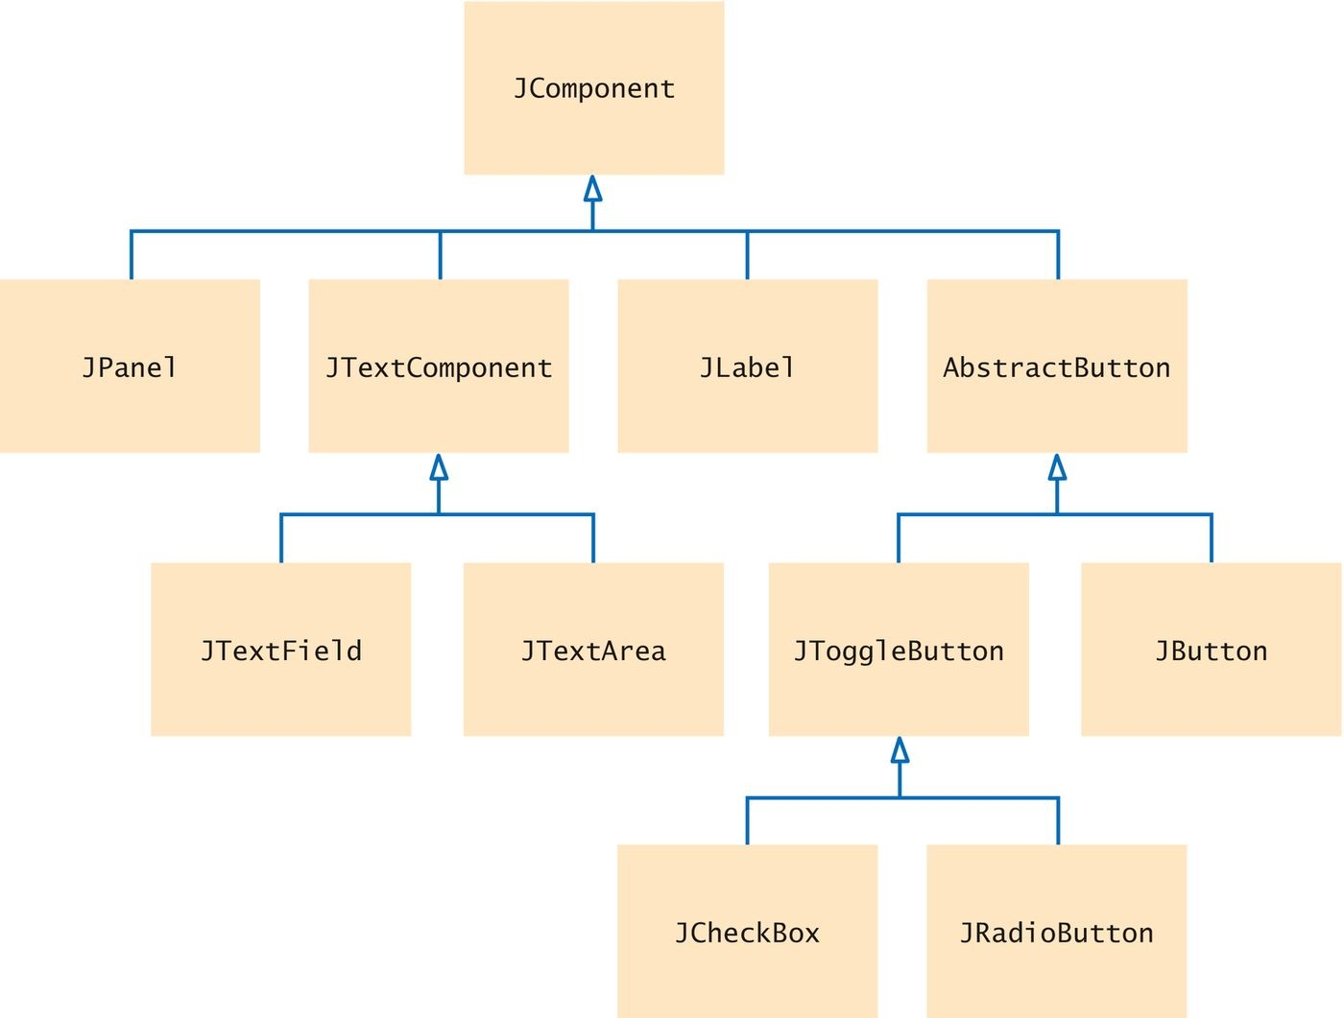
TextComponent Class
JTextField and JTextArea are subclasses of
JTextComponent.
setText and setEditable are declared in the
JTextComponent class.
Inherited by JTextField and JTextArea.
append method is only declared in JTextArea.
Figure 5 A Part of the Hierarchy of Swing User-Interface Components

Slide 23
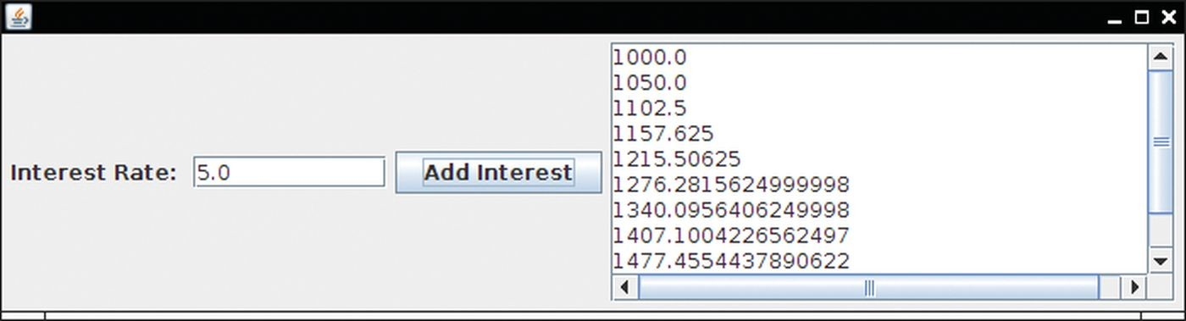
Scrolling
To add scroll bars, use JScrollPane:
JScrollPane scrollPane = new JScrollPane(textArea);
Figure 6 The Investment Application with a Text Area Inside Scroll Bars

Slide 24
section_2_2/InvestmentFrame3.java
import java.awt.event.ActionEvent;
import java.awt.event.ActionListener;
import javax.swing.JButton;
import javax.swing.JFrame;
import javax.swing.JLabel;
import javax.swing.JPanel;
import javax.swing.JScrollPane;
import javax.swing.JTextArea;
import javax.swing.JTextField;
10
11
12
13
14
15
16
17
18
19
20
21
22
23
24
25
26
27
28
29
30
31
32
/**
A frame that shows the growth of an investment with variable interest, using a text area.
*/
public class InvestmentFrame3 extends JFrame
{
private static final int FRAME_WIDTH = 400; private static final int FRAME_HEIGHT = 250;
private static final int AREA_ROWS = 10; private static final int AREA_COLUMNS = 30;
private static final double DEFAULT_RATE = 5; private static final double INITIAL_BALANCE = 1000;
private JLabel rateLabel; private JTextField rateField; private JButton button; private JTextArea resultArea; private double balance;
public InvestmentFrame3()

Slide 25
Self Check 20.9
What happens if you omit the first JLabel object in the program of Section 20.2.1?
Answer: Then the text field is not labeled, and the user will not know its purpose.

Slide 26
Self Check 20.10
If a text field holds an integer, what expression do you use to read its contents?
Answer: Integer.parseInt(textField.getText())

Slide 27
Self Check 20.11
What is the difference between a text field and a text area?
Answer: A text field holds a single line of text; a text area holds multiple lines.

Slide 28
Self Check 20.12
Why did the InvestmentFrame3 program call
resultArea.setEditable(false)?
Answer: The text area is intended to display the program output. It does not collect user input.

Slide 29
Self Check 20.13
How would you modify the InvestmentFrame3 program if you didn’t want to use scroll bars?
Answer: Don’t construct a JScrollPane but add the
resultArea object directly to the panel.

Slide 30
Choices
GUI components for selections:
Radio Buttons For a small set of mutually exclusive choices. Check Boxes For a binary choice.
Combo Boxes For a large set of choices.

Slide 31
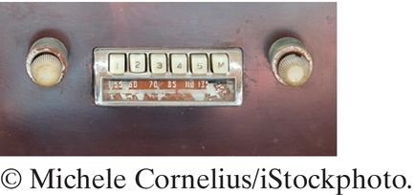
Radio Buttons
Only one button in a set can be selected. Selecting a button clears previous selection.
In an old fashioned radio, pushing down one station button released the others.
Create each button individually.
Add all buttons in the set to a ButtonGroup object:
JRadioButton smallButton = new JRadioButton("Small"); JRadioButton mediumButton = new JRadioButton("Medium"); JRadioButton largeButton = new JRadioButton("Large"); ButtonGroup group = new ButtonGroup(); group.add(smallButton);
group.add(mediumButton); group.add(largeButton);
Use isSelected to find out whether a button is selected, like:
if (largeButton.isSelected()) { size = LARGE_SIZE; }

Slide 32
Radio Button Panels
Use a panel for each set of radio buttons.
The default border for a panel is invisible (no border). You can add a border to a panel to make it visible.
Also add a title.
JPanel panel = new JPanel(); panel.add(smallButton); panel.add(mediumButton); panel.add(largeButton);
panel.setBorder(new TitledBorder(new EtchedBorder(),"Size"));

Slide 33
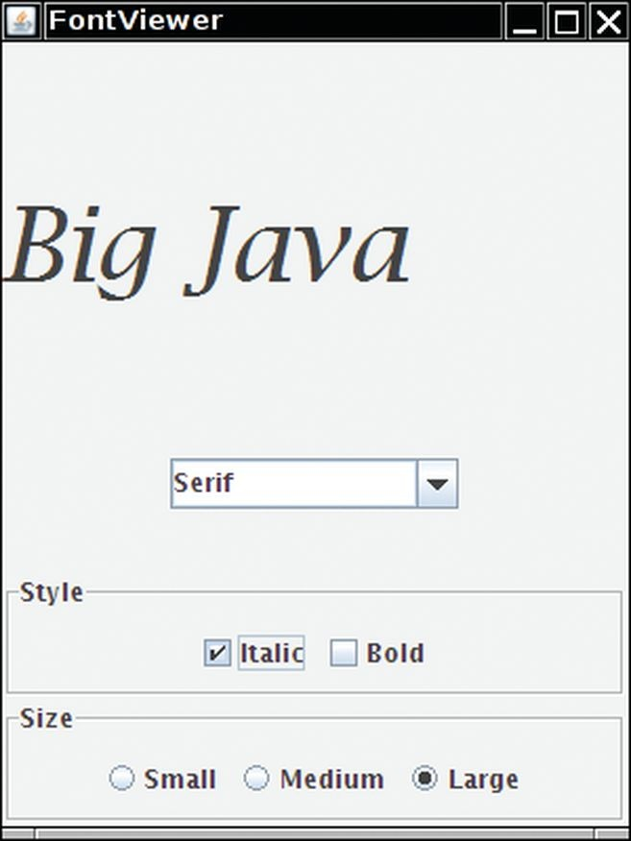
User Interface Components
Figure 7 A Combo Box, Check Boxes, and Radio Buttons

Slide 34
Check Boxes
A check box has two states: checked and unchecked. Use for choices that are not mutually exclusive.
For example in Figure 7, text may be Italic, Bold, both or neither.
Because check box settings do not exclude each other, you do not need to place a set of check boxes inside a button group.
Radio buttons are round and have a black dot when selected. Check boxes are square and have a check mark when selected. Construct a text box:
JCheckBox italicCheckBox = new JCheckBox("Italic");
Use isSelected to find out whether a check box is selected.

Slide 35
Combo Boxes
A combo box is a combination of a list and a text field. Clicking the arrow to the right of the text field opens the list of selections.
Use a combo box for a large set of choices.
Use when radio buttons would take up too much space. It can be either:
Closed (shows one selection). Open, showing multiple selections.
It can also be editable:
Type a selection into a blank line.
facenameCombo.setEditable();

Slide 36
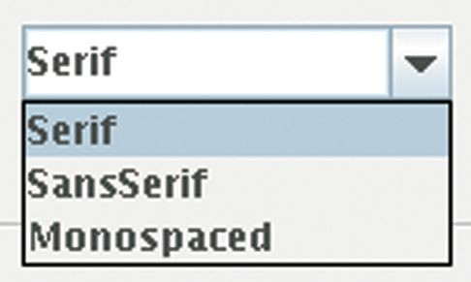
Adding and Selecting Items
Add text ‘items’ to a combo box that will show in the list:
Use the getSelectedItem method to return the selected item (as an Object).
Combo boxes can store other objects in addition to strings, so casting to a string may be required:
JComboBox facenameCombo = new JComboBox(); facenameCombo.addItem("Serif"); facenameCombo.addItem("SansSerif");
. . .
String selectedString = (String) facenameCombo.getSelectedItem();
Figure 8 An Open Combo Box

Slide 37
Handling Input Events
Radio buttons, check boxes, and combo boxes generate an
ActionEvent when selected.
In FontViewer program, listener gets all events.
Simply check the state of each component using isSelected
and getSelectedItem methods.
Then redraw the label with the new font.

Slide 38
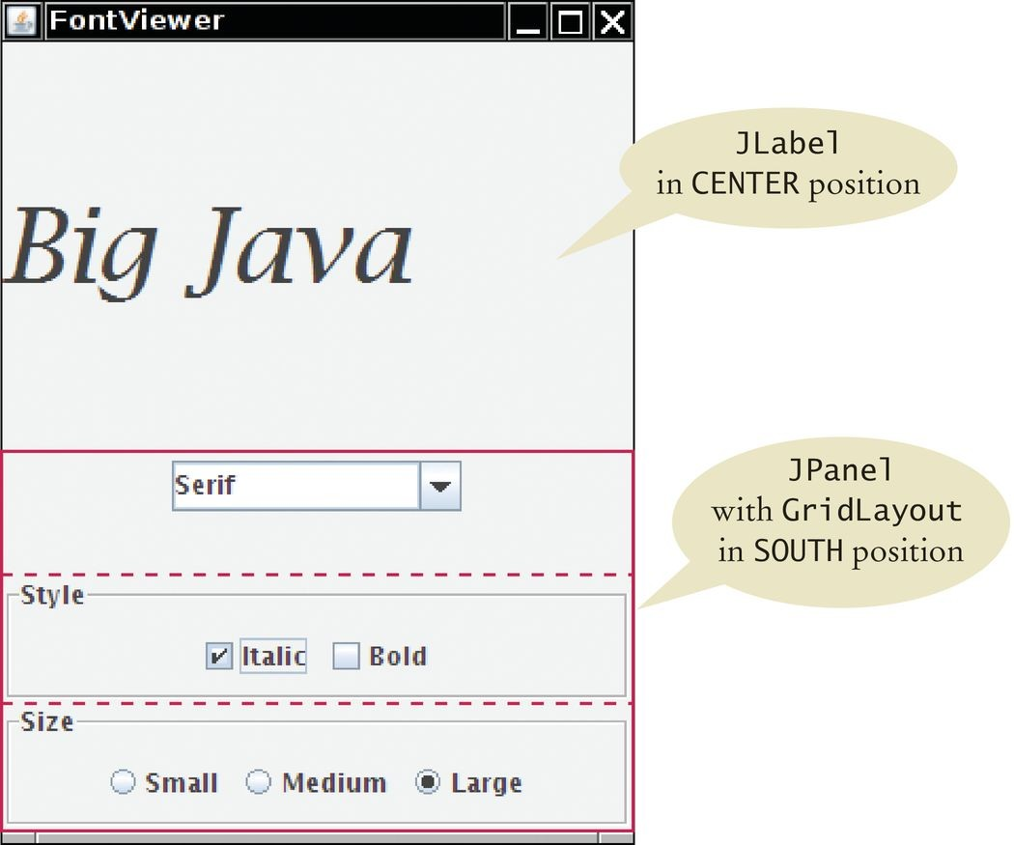
FontViewer
Figure 9 The Components of the Font Frame

Slide 39
section_3/FontViewer.java
1 import javax.swing.JFrame;
2
3 /**
4 This program allows the user to view font effects.
5 */
6 public class FontViewer
7 {
8 public static void main(String[] args)
9 {
JFrame frame = new FontFrame();
frame.setDefaultCloseOperation(JFrame.EXIT_ON_CLOSE);
frame.setTitle("FontViewer");
frame.setVisible(true);
14 }
15 }

Slide 40
section_3/FontFrame.java
import java.awt.BorderLayout;
import java.awt.Font;
import java.awt.GridLayout;
import java.awt.event.ActionEvent;
import java.awt.event.ActionListener;
import javax.swing.ButtonGroup;
import javax.swing.JButton;
import javax.swing.JCheckBox;
import javax.swing.JComboBox;
import javax.swing.JFrame;
import javax.swing.JLabel;
import javax.swing.JPanel;
import javax.swing.JRadioButton;
import javax.swing.border.EtchedBorder;
import javax.swing.border.TitledBorder;
16
17
18
19
20
21
22
23
24
25
26
27
28
29
30
31
32
33
34
35
36
/**
This frame contains a text sample and a control panel to change the font of the text.
*/
public class FontFrame extends JFrame
{
private static final int FRAME_WIDTH = 300; private static final int FRAME_HEIGHT = 400;
private JLabel label;
private JCheckBox italicCheckBox; private JCheckBox boldCheckBox; private JRadioButton smallButton; private JRadioButton mediumButton; private JRadioButton largeButton; private JComboBox facenameCombo; private ActionListener listener;
/**
Constructs the frame.

Slide 41
Self Check 20.14
What is the advantage of a JComboBox over a set of radio buttons? What is the disadvantage?
Answer: If you have many options, a set of radio buttons takes up a large area. A combo box can show many options without using up much space. But the user cannot see the options as easily.

Slide 42
Self Check 20.15
What happens when you put two check boxes into a button group? Try it out if you are not sure.
Answer: If one of them is checked, the other one is unchecked. You should use radio buttons if that is the behavior you want.

Slide 43
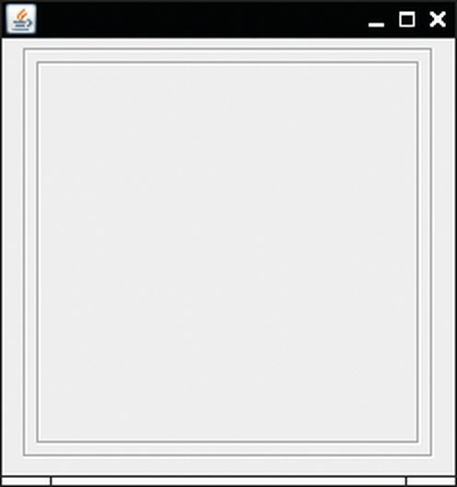
Self Check 20.16
How can you nest two etched borders, like this?
Answer: You can’t nest borders, but you can nest panels with borders:
JPanel p1 = new JPanel(); p1.setBorder(new EtchedBorder()); JPanel p2 = new JPanel(); p2.setBorder(new EtchedBorder()); p1.add(p2);

Slide 44
Self Check 20.17
Why do all user-interface components in the FontFrame class share the same listener?
Answer: When any of the component settings is changed, the program simply queries all of them and updates the label.

Slide 45
Self Check 20.18
Why was the combo box placed inside a panel? What would have happened if it had been added directly to the control panel?
Answer: To keep it from growing too large. It would have grown to the same width and height as the two panels below it.

Slide 46

Self Check 20.19
How could the following user interface be improved?
Answer: Instead of using radio buttons with two choices, use a checkbox.

Slide 47
Designing a User Interface
Make a sketch of the component layout. Draw all the buttons, labels, text fields, and borders on a sheet of graph paper.
Find groupings of adjacent components with the same layout. Look for adjacent components top to bottom or left to right.
Identify layouts for each group:
For horizontal components, use flow layout.
For vertical components, use a grid layout with one column.
Group the groups together:
Look at each group as one blob.
Group the blobs together into larger groups.

Slide 48
Designing a User Interface
Write the code to generate the layout.
JPanel radioButtonPanel = new JPanel(); radioButtonPanel.setLayout(new GridLayout(3, 1)); radioButton.setBorder(new TitledBorder(new EtchedBorder(), "Size")); radioButtonPanel.add(smallButton); radioButtonPanel.add(mediumButton); radioButtonPanel.add(largeButton);
JPanel checkBoxPanel = new JPanel(); checkBoxPanel.setLayout(new GridLayout(2, 1)); checkBoxPanel.add(pepperoniButton()); checkBoxPanel.add(anchoviesButton());
JPanel pricePanel = new JPanel();
// Uses FlowLayout by default pricePanel.add(new JLabel("Your Price:")); pricePanel.add(priceTextField);
JPanel centerPanel = new JPanel(); // Uses FlowLayout centerPanel.add(radioButtonPanel); centerPanel.add(checkBoxPanel);
// Frame uses BorderLayout by default add(centerPanel, BorderLayout.CENTER); add(pricePanel, BorderLayout.SOUTH);

Slide 49
Use a GUI Builder
A GUI builder reduces the tedious work:
Drag and drop components onto a panel.
Customize fonts, colors, text, and so on with a dialog box.
Define event handlers by picking the event to process and provide the code snippet for the listener method.
Powerful layout manager GroupLayout designed to be used by GUI builders.

Slide 50
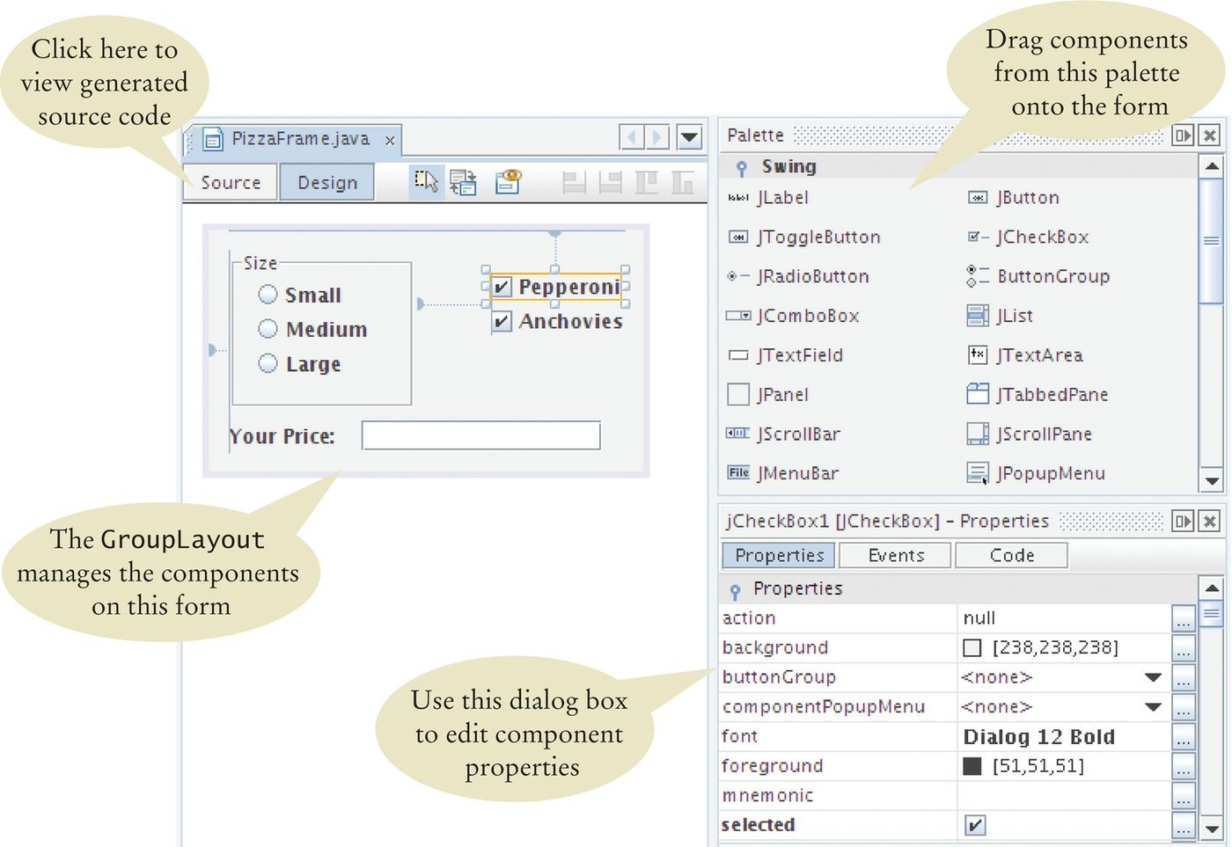
Use a GUI Builder
Try the free NetBeans development environment, available from
http://netbeans.org.
Figure 10 A GUI Builder

Slide 51
Menus
A frame can contain a menu bar. Menu bar contains menus.
Menu contains submenus and menu items.
Menu items can be added to each menu or submenu. First, add the menu bar to the frame:
public class MyFrame extends JFrame
{
public MyFrame()
{
JMenuBar menuBar = new JMenuBar(); setJMenuBar(menuBar);
. . .
}
. . .
}

Slide 52
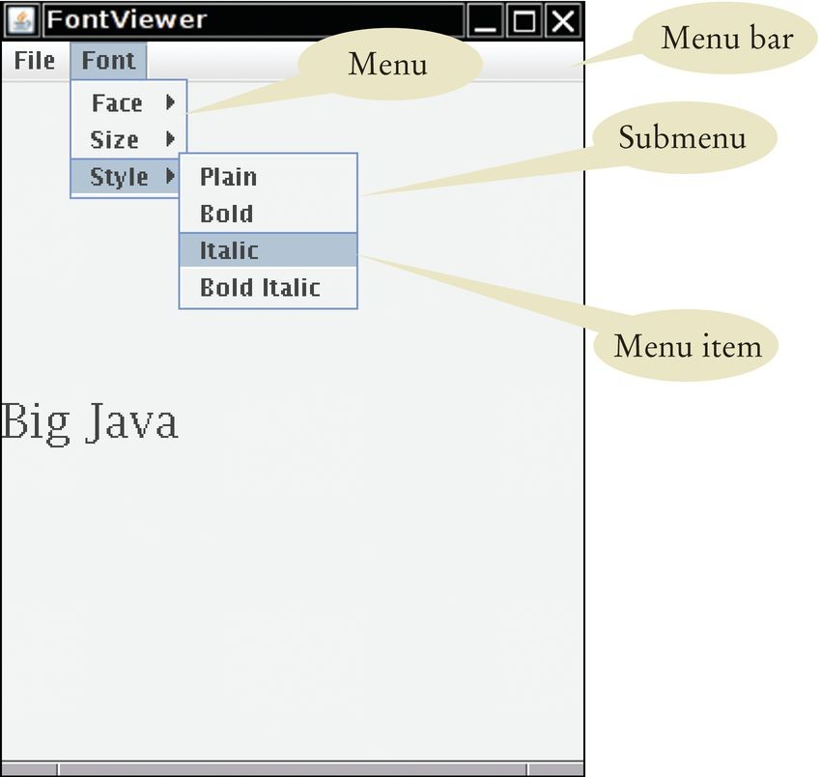
Menus
Figure 11 Pull-Down Menus

Slide 53
Menus
Add menus to the menu bar:
JMenu fileMenu = new JMenu("File"); JMenu fontMenu = new JMenu("Font"); menuBar.add(fileMenu); menuBar.add(fontMenu);
Add menu items and subitems:
JMenuItem exitItem = new JMenuItem("Exit"); fileMenu.add(exitItem);
JMenu styleMenu = new JMenu("Style"); fontMenu.add(styleMenu); // A submenu
Add a listener to each menu item (not to menus or menu bar):
ActionListener listener = new ExitItemListener(); exitItem.addActionListener(listener);

Slide 54
Menus
Use a separate method for each menu or set of related menus:
public JMenu createFaceMenu()
{
JMenu menu = new JMenu("Face"); menu.add(createFaceItem("Serif")); menu.add(createFaceItem("SansSerif")); menu.add(createFaceItem("Monospaced")); return menu;
}

Slide 55
Menus
createFaceItem method needs to set the font face:
Set the current face name.
Make the new font from the current face, size, and style, and apply it to label.
Create a FaceItemListener class to listen for face item name actions:
class FaceItemListener implements ActionListener
{
private String name;
public FaceItemListener(String newName) { name = newName; } public void actionPerformed(ActionEvent event)
{
faceName = name; // Sets an instance variable of the frame class setLabelFont();
}
}
Install a listener object with the appropriate name:
public JMenuItem createFaceItem(String name)
{
JMenuItem item = new JMenuItem(name);
ActionListener listener = new FaceItemListener(name); item.addActionListener(listener);
return item;
}

Slide 56
Menus
Better to make a local inner class in the createFaceItem
method.
actionPerformed method can access the name parameter variable directly (rather than passing it).
public JMenuItem createFaceItem(final String name)
// Final variables can be accessed from an inner class method
{
class FaceItemListener implements ActionListener
// A local inner class
{
public void actionPerformed(ActionEvent event)
{
facename = name; // Accesses the local variable name setLabelFont();
}
}
JMenuItem item = new JMenuItem(name);
ActionListener listener = new FaceItemListener(name); item.addActionListener(listener);
return item;
}
Same strategy used for the createSizeItem and
createStyleItem methods.

Slide 57
section_4/FontViewer2.java
1 import javax.swing.JFrame;
2
3 /**
4 This program uses a menu to display font effects.
5 */
6 public class FontViewer2
7 {
8 public static void main(String[] args)
9 {
JFrame frame = new FontFrame2();
frame.setDefaultCloseOperation(JFrame.EXIT_ON_CLOSE);
frame.setTitle("FontViewer");
frame.setVisible(true);
14 }
15 }

Slide 58
section_4/FontFrame2.java
import java.awt.BorderLayout;
import java.awt.Font;
import java.awt.event.ActionEvent;
import java.awt.event.ActionListener;
import javax.swing.JFrame;
import javax.swing.JLabel;
import javax.swing.JMenu;
import javax.swing.JMenuBar;
import javax.swing.JMenuItem;
10
11
12
13
14
15
16
17
18
19
20
21
22
23
24
25
26
27
28
29
30
31
32
33
34
35
/**
This frame has a menu with commands to change the font of a text sample.
*/
public class FontFrame2 extends JFrame
{
private static final int FRAME_WIDTH = 300; private static final int FRAME_HEIGHT = 400;
private JLabel label; private String facename; private int fontstyle; private int fontsize;
/**
Constructs the frame.
*/
public FontFrame2()
{
// Construct text sample
label = new JLabel("Big Java"); add(label, BorderLayout.CENTER);
// Construct menu
JMenuBar menuBar = new JMenuBar();

Slide 59
Self Check 20.20
Why do JMenu objects not generate action events?
Answer: When you open a menu, you have not yet made a selection. Only JMenuItem objects correspond to selections.

Slide 60
Self Check 20.21
Can you add a menu item directly to the menu bar? Try it out. What happens?
Answer: Yes, you can—JMenuItem is a subclass of JMenu. The item shows up on the menu bar. When you click on it, its listener is called. But the behavior feels unnatural for a menu bar and is likely to confuse users.

Slide 61
Self Check 20.22
Why is the increment parameter variable in the createSizeItem method declared as final?
Answer: The parameter variable is accessed in a method of an inner class.

Slide 62
Self Check 20.23
Why can’t the createFaceItem method simply set the faceName instance variable, like this:
class FaceItemListener implements ActionListener
{
public void actionPerformed(ActionEvent event)
{
setLabelFont();
}
}
public JMenuItem createFaceItem(String name)
{
JMenuItem item = new JMenuItem(name); faceName = name;
ActionListener listener = new FaceItemListener(); item.addActionListener(listener);
return item;
}
Answer: Then the faceName variable is set when the menu item is added to the menu, not when the user selects the menu.

Slide 63
Self Check 20.24
In this program, the font specification (name, size, and style) is stored in instance variables. Why was this not necessary in the program of the previous section?
Answer: In the previous program, the user-interface components effectively served as storage for the font specification. Their current settings were used to construct the font. But a menu doesn’t save settings; it just generates an action.

Slide 64
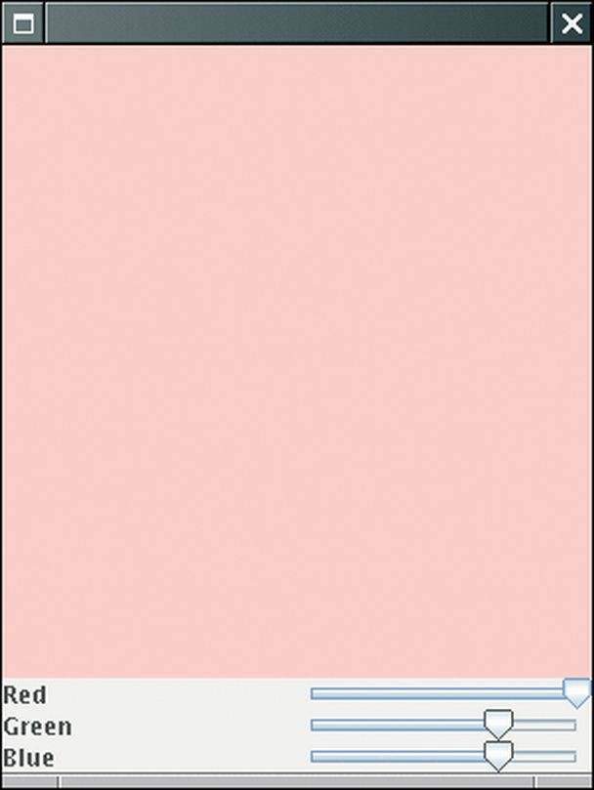
Exploring the Swing Documentation
Consider an example application: Use sliders to set colors of red, green and blue.
Swing user-interface toolkit provides a large set of components. How do you know if there is a slider?
Buy a book that illustrates all Swing components.
Run the sample Swing application included in the Java Development Kit. Look at the names of all of the classes that start with J and decide that JSlider may be a good candidate.
Figure 12 A Color Viewer with Sliders

Slide 65
JSlider Documentation and Use
Now ask some questions about JSlider:
How do I construct a JSlider?
How can I get notified when the user has moved it? How can I tell to which value the user has set it?
Unfortunately, documentation for JSlider is voluminous:
Over 50 methods in the JSlider class. Over 250 inherited methods.
Some of the method descriptions look downright scary.
Concentrate on what you will need:
Constructors. Event handling. Get the value.

Slide 66
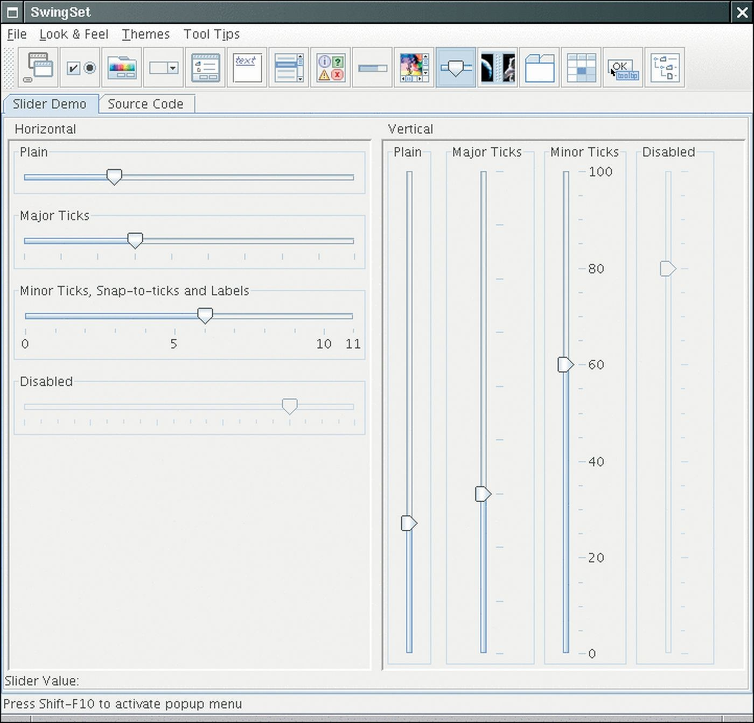
SwingSet Demo
Figure 13 The SwingSet Demo

Slide 67
JSlider Constructor Choice
We want a slider value between 0 and 255. Find a constructor that will do what we need:
public JSlider()
Creates a horizontal slider with the range 0 to 100 and an initial value of 50.
public JSlider(BoundedRangeModel brm)
Creates a horizontal slider using the specified
BoundedRangeModel.
public JSlider(int min, int max, int value)
Creates a horizontal slider using the specified min, max, and value.

Slide 68
JSlider Event Handling
Goal: Add a change event listener to each slider. There is no addActionListener method.
Possible option:
public void addChangeListener(ChangeListener l)
Looks like AddActionListener calls stateChanged(ChangeEvent e) whenever the user adjusts the slider.

Slide 69
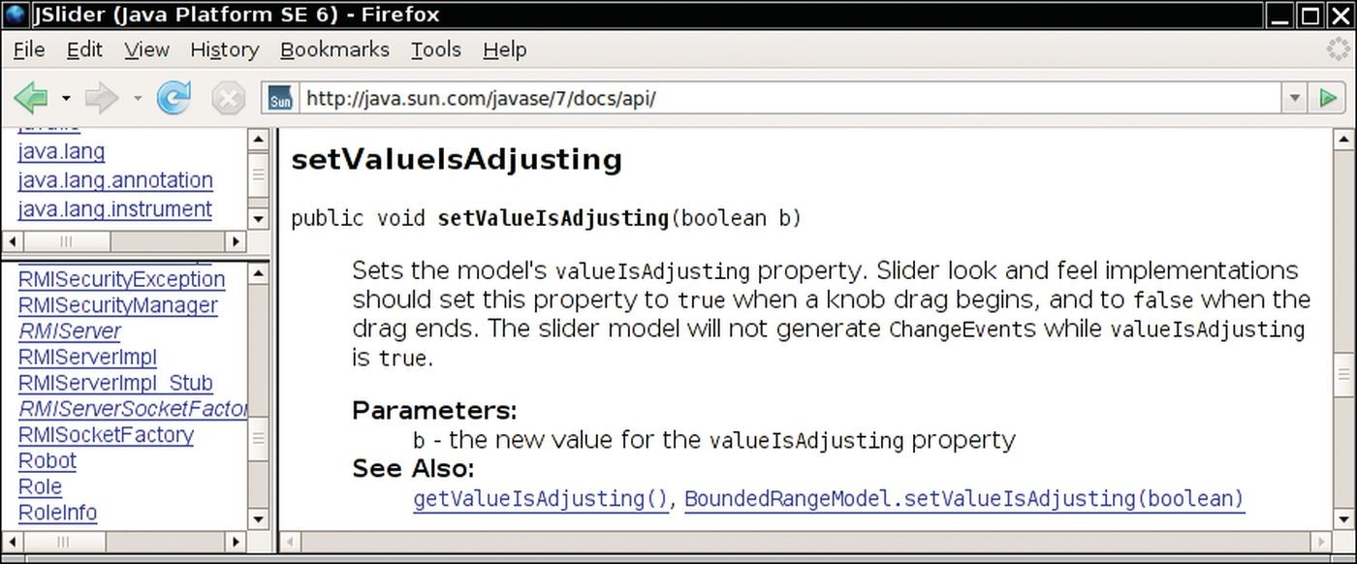
Figure 14 A Mysterious Method Description from the API Documentation

Slide 70
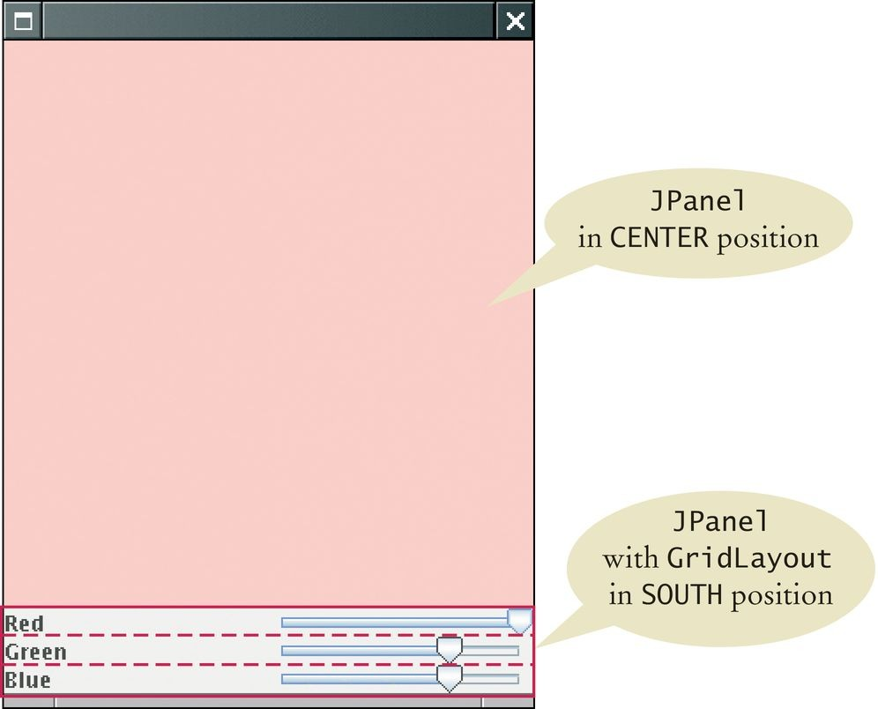
JSlider Event Handling
So the plan is:
Setup three sliders and one ChangeListener object.
Use AddChangeListener, passing our ChangeListener to each slider.
In the stateChanged method, check the values of the colors and repaint the panel.
Figure 15 The Components of the Color Viewer Frame

Slide 71
section_5/ColorViewer.java
1 import javax.swing.JFrame;
2
3 public class ColorViewer
4 {
5 public static void main(String[] args)
6 {
JFrame frame = new ColorFrame();
frame.setDefaultCloseOperation(JFrame.EXIT_ON_CLOSE);
frame.setVisible(true);
10 }
11 }

Slide 72
section_5/ColorFrame.java
import java.awt.BorderLayout;
import java.awt.Color;
import java.awt.GridLayout;
import javax.swing.JFrame;
import javax.swing.JLabel;
import javax.swing.JPanel;
import javax.swing.JSlider;
import javax.swing.event.ChangeListener;
import javax.swing.event.ChangeEvent;
10
11
12
13
14
15
16
17
18
19
20
21
22
23
24
25
26
27
28
29
30
31
32
33
34
35
36
public class ColorFrame extends JFrame
{
private static final int FRAME_WIDTH = 300; private static final int FRAME_HEIGHT = 400;
private JPanel colorPanel; private JSlider redSlider; private JSlider greenSlider; private JSlider blueSlider;
public ColorFrame()
{
colorPanel = new JPanel();
add(colorPanel, BorderLayout.CENTER); createControlPanel(); setSampleColor(); setSize(FRAME_WIDTH, FRAME_HEIGHT);
}
class ColorListener implements ChangeListener
{
public void stateChanged(ChangeEvent event)
{
setSampleColor();
}

Slide 73
Self Check 20.25
Suppose you want to allow users to pick a color from a color dialog box. Which class would you use? Look in the API documentation.
Answer: JColorChooser.

Slide 74
Self Check 20.26
Why does a slider emit change events and not action events?
Answer: Action events describe one-time changes, such as button clicks. Change events describe continuous changes.

